Slide 1

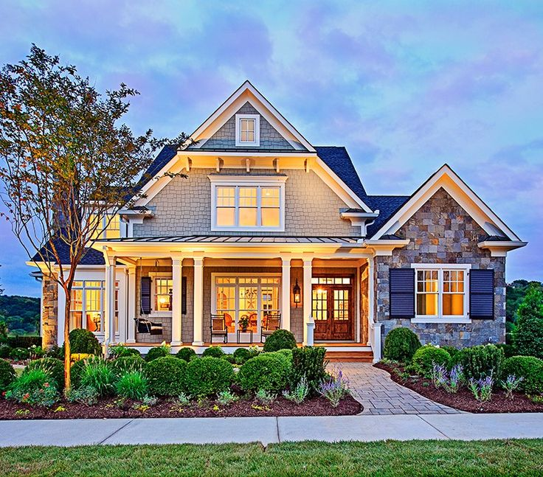
UT Data Visualization & Analytics
Austin Home
Affordability
Lonnie Hendry
John Swyers
Carlos Guevara
Ke (Kelly) Zhao

Slide 2
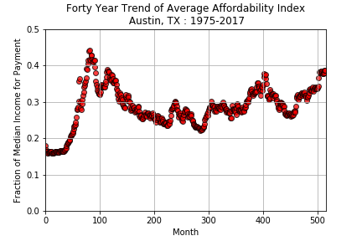
Is House Still Affordable?
Peak
Interest
Rates
in
1980s
Great Recession

Slide 3
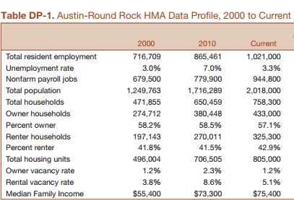
Break Down
Ideal Dataset
2,000,000 surveys
100% completion rates
Very personal Questions
Narrowed Dataset
Austin City Limits
Exclude Rentors
Single Family Houses
MLS Listed
“Responsible” Budgt
Recent Data

Slide 4

Median Income in Austin
$58,281
$60,070
$64,201
$67,104
$69,950
Home Sales in Austin
2013 11,583 Sales
2014 11,092 Sales
2015 11,394 Sales
2016 11,554 Sales
2017 10,488 Sales

Slide 5
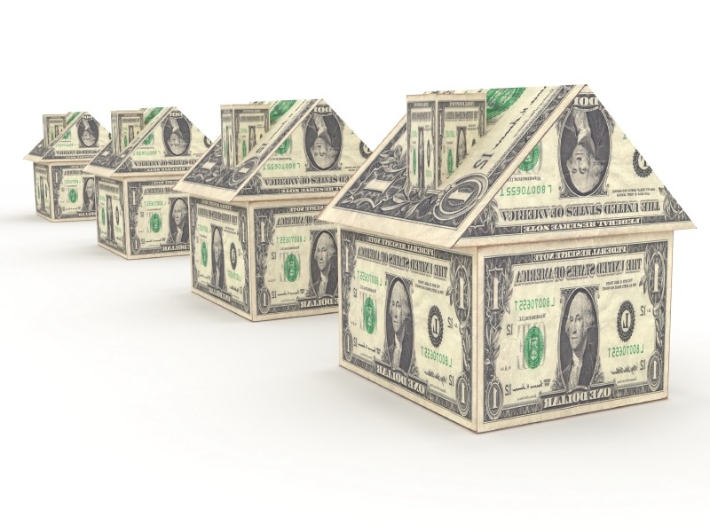
Can
a first time buyer
afford to buy a home in Austin?

Slide 6
What does “affordable” mean?
Housing expense < 30% of median income by year
Who is the first time home buyer?
Median Income
25 – 44 years old
Is the answer the same for the entire city or what portion?
Single Family Sales Aggregates by Zip Code
What timeframe is considered?
01/01/2013 – 10/31/2017
Examined Monthly
APR 3.87% Annual Property Tax 2.5% Insurance 0.5% / Yr.

Slide 7
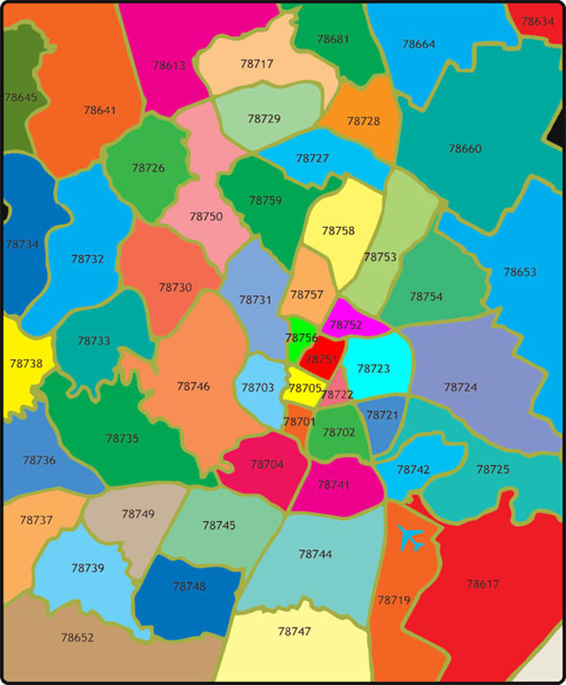
What zip codes in Austin would our first-time homebuyer
be able to afford?

Slide 8




Data Source
MLS
Data USA
Census data
Pandas
Matplotlib
Tableau

Slide 9
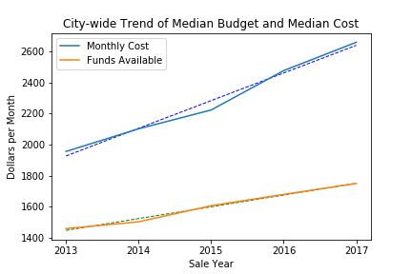
City-wide Affordability
01/01/2013 – 10/31/2017

Slide 10
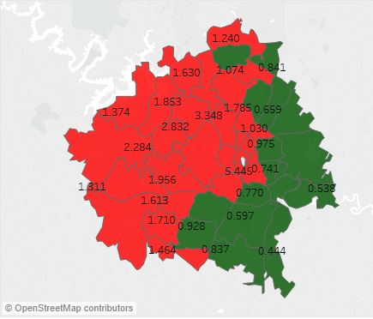
Affordability Breakdown by Zip Code 2013
Total House Cost / Funds Available
APR 3.87%
Annual Property Tax 2.5%
Insurance 0.5% / Yr.

Slide 11
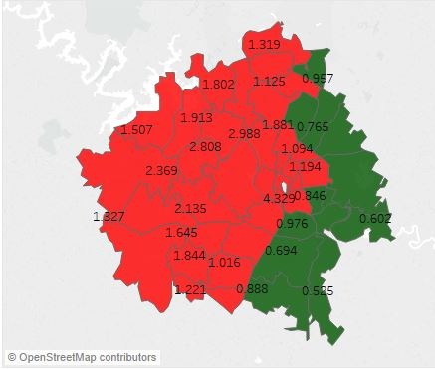
Affordability Breakdown by Zip Code 2014
Total House Cost / Funds Available
APR 3.87%
Annual Property Tax 2.5%
Insurance 0.5% / Yr.

Slide 12

Affordability Breakdown by Zip Code 2015
Total House Cost / Funds Available
APR 3.87%
Annual Property Tax 2.5%
Insurance 0.5% / Yr.

Slide 13
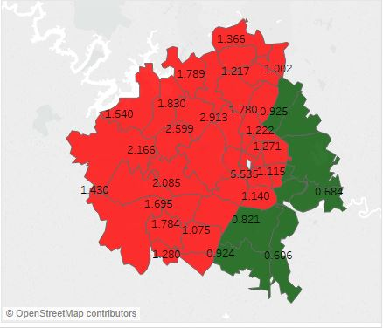
Affordability Breakdown by Zip Code 2016
Total House Cost / Funds Available
APR 3.87%
Annual Property Tax 2.5%
Insurance 0.5% / Yr.

Slide 14

Affordability Breakdown by Zip Code 2017
Total House Cost / Funds Available
APR 3.87%
Annual Property Tax 2.5%
Insurance 0.5% / Yr.

Slide 15
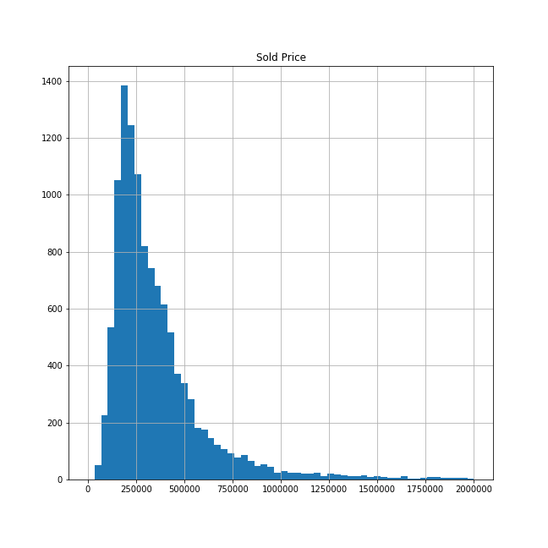
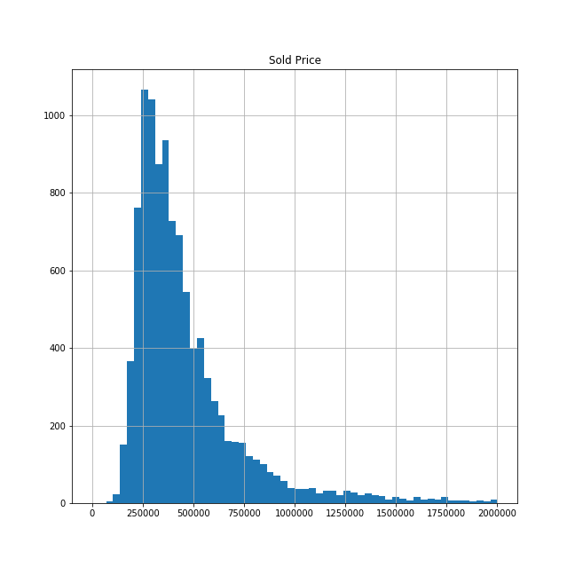
Sales Value Distributions Support Median for Population Modelling
2013 City Wide Sales
Skew = 4.8
2017 City Wide Sales
Skew = 14.9

Slide 16
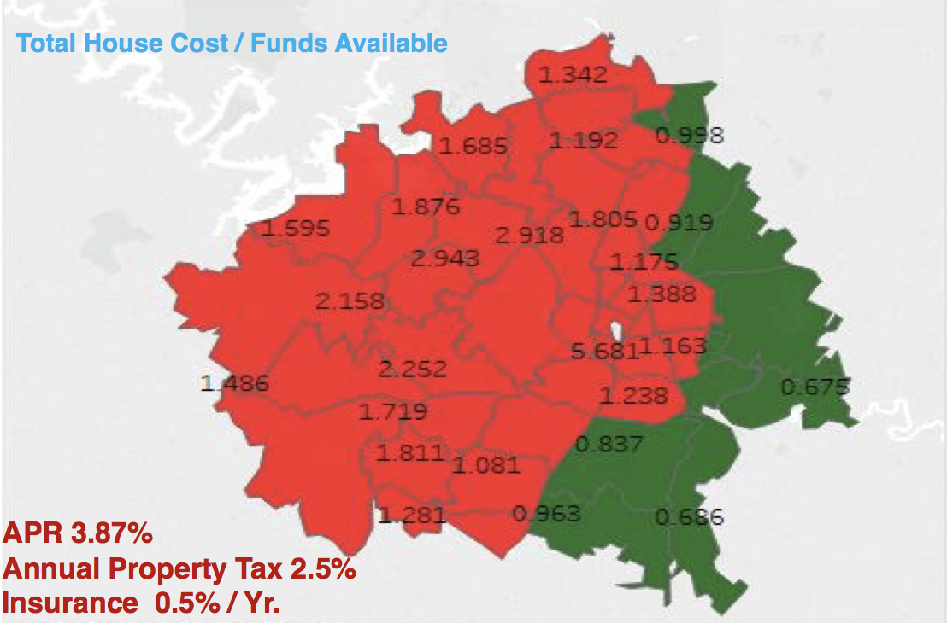
Conclusions
City-wide median shows no general affordability
However, some locations were still affordable
Trends show accelerating budget gap at median income
Likely many households exceed the 30% spend criterion in Austin

Slide 17
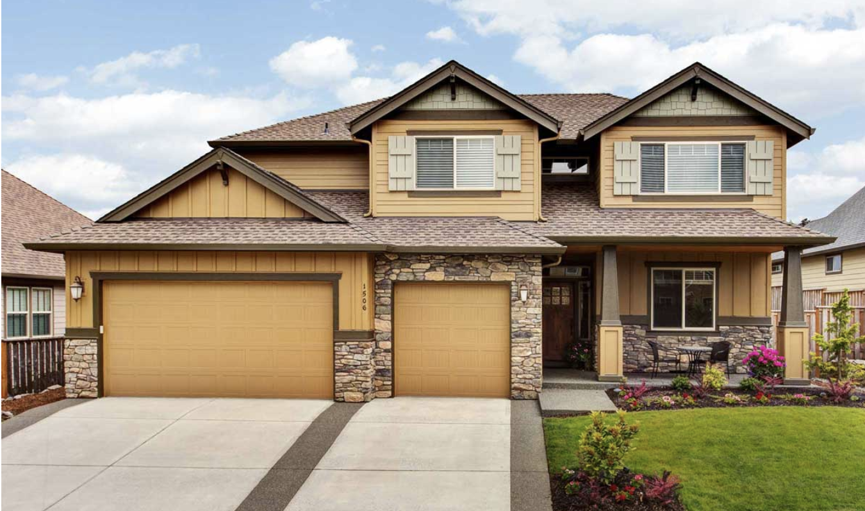
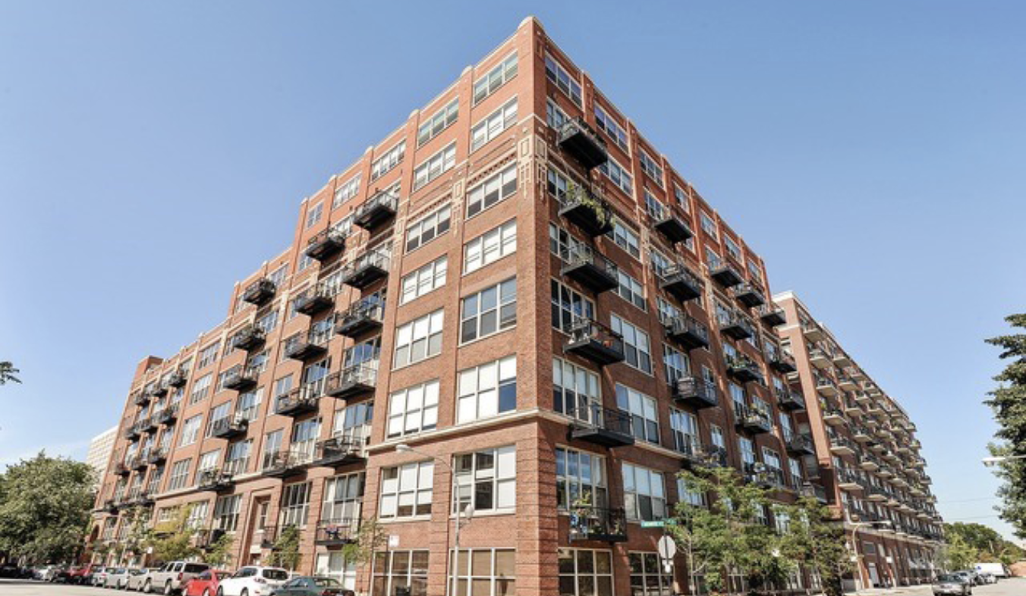
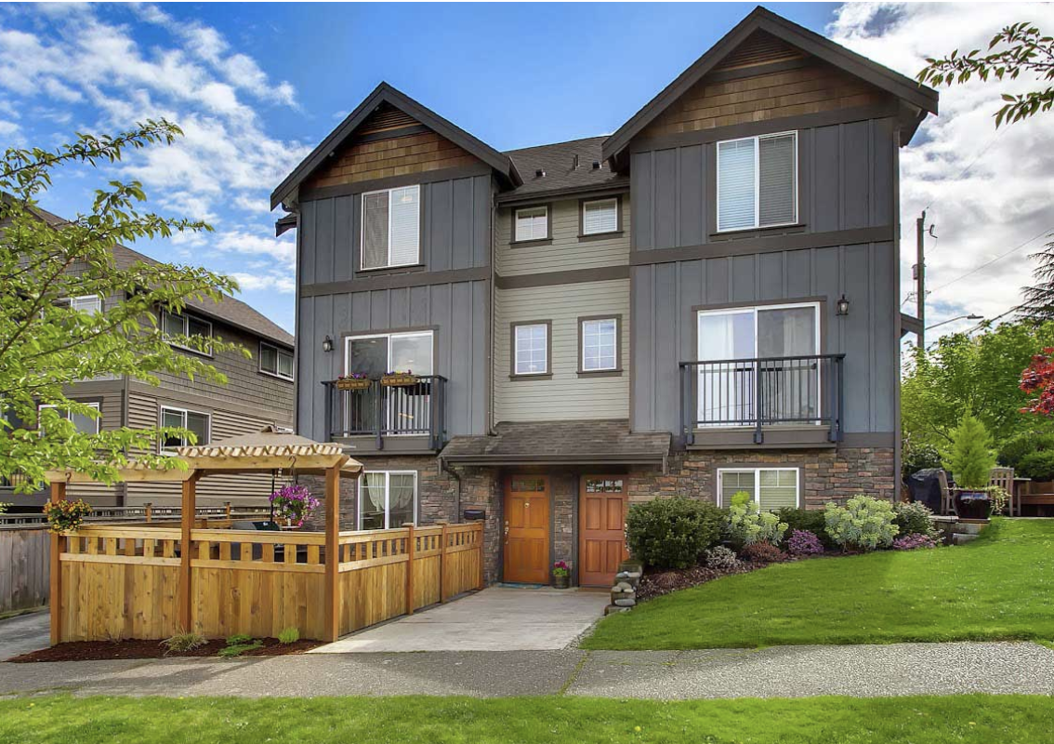

Data and Analysis Limitations
Only considered single family homes
Dual-income buyers excluded
No clarity on down payment availability
Static interest rate and tax rate applied

Slide 18

Take away…
Austin is no longer affordable to first time buyers
Multi-family and rental options likely to rise if current trends continue

Slide 19

Questions?

Slide 20
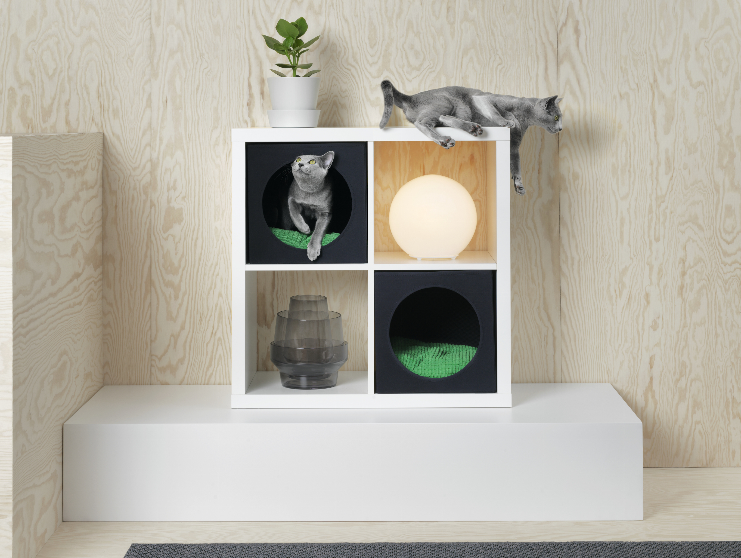
Thank You!

